Slide 1

FSD MINI-PROJECT
Student Portfolio
Builder
STUDENT PROFILE
Your Name
Build your story
Skills, projects, education
and achievements — in one place.
Create. Organize. Showcase.
A web application for creating and managing student portfolios.
Skills
Projects
React.js
Express.js
MongoDB Atlas
Education
Presented by: [Your Name] • Class/Section: [Your Class]
01 / 09

Slide 2
01 • PROJECT OVERVIEW
02
Introduction
A student portfolio is a single place to present academic and personal achievements in a clear, organized way.
Purpose
Format
Outcome
Present skills, projects, education and achievements in one place.
A web-based application accessible through a browser.
A convenient profile to share with faculty, recruiters or peers.
Full-stack connection: React frontend → Express API → MongoDB database

Slide 3
02 • WHY THIS PROJECT?
03
Problem Statement
Student information can be scattered, making it harder to present a complete profile.
01
Scattered details
02
Time-consuming
Academic details, skills and projects may live across different documents and platforms.
Preparing a portfolio manually can take time and require repeated formatting.
03
Hard to update
04
Need for one place
Static documents can be inconvenient to update as students gain experience.
Students need a simple way to organize and present their information.

Slide 4
03 • OUR APPROACH
04
Proposed Solution
Build a simple web app where students can create, view and manage portfolio information.
01
Enter information
02
Send requests
03
Store data
Add profile details and portfolio content using the web interface.
→
The React frontend communicates with the Express.js backend API.
→
The backend uses MongoDB Atlas to store and retrieve portfolio records.
Deployed online • Open the application through a shareable website link

Slide 5
04 • TECHNOLOGY STACK
05
Technologies Used
React.js
Express.js + Node.js
MongoDB Atlas
Interactive frontend and user interface.
Backend routes and API request handling.
Cloud database for portfolio data.
Vite
Vercel
Render + GitHub
Frontend development server and production build.
Hosts the deployed frontend website.
Render hosts the backend; GitHub stores source code.
Together, these tools form a full-stack web application.

Slide 6
05 • MAIN APPLICATION
06
About the Portfolio
A student's profile page is a structured summary of who they are and what they have worked on.
STUDENT PROFILE
Your Name
Personal profile
Student • Developer
Education & academics
SKILLS
PROJECTS
EDUCATION
Technical skills
Projects & achievements
Browser-friendly presentation
Illustrative profile preview

Slide 7
06 • APPLICATION WORKFLOW
07
How the System Works
1
User interacts
2
API request
3
Database operation
4
Response
→
→
→
Student enters or views portfolio information in React.
Frontend sends a request to the Express backend.
Backend reads or writes records in MongoDB Atlas.
API returns data and the frontend updates the page.
Deployment: Vercel (frontend) ↔ Render (backend) ↔ MongoDB Atlas (database)

Slide 8
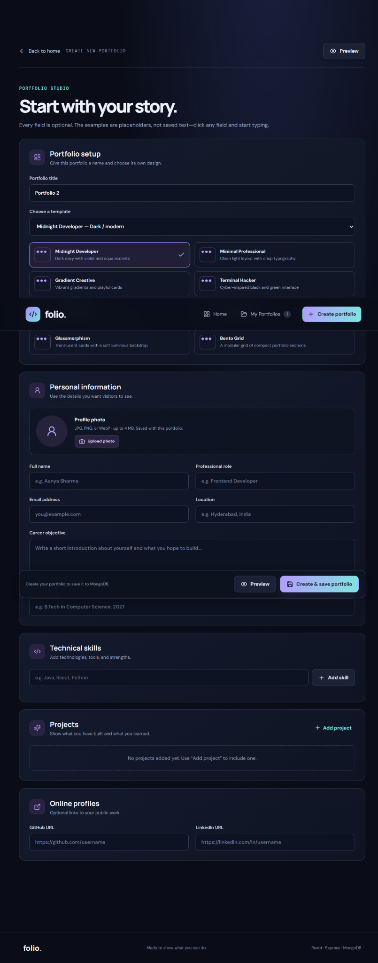
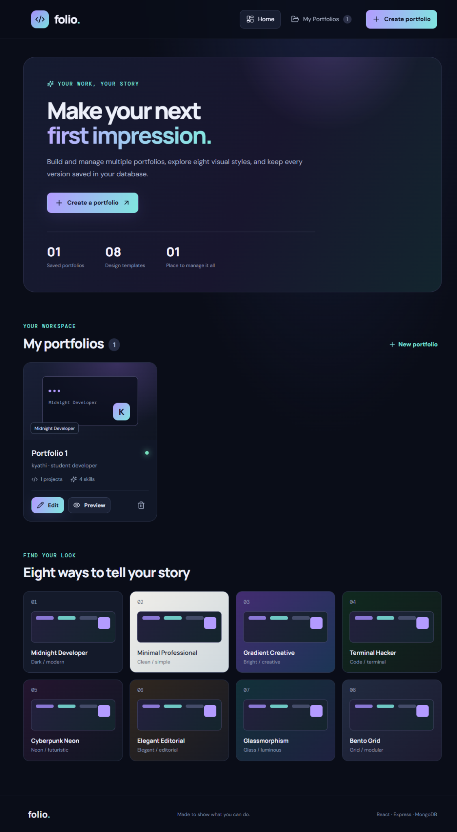
LIVE WEBSITE WALKTHROUGH
Create and manage portfolios
1. Portfolio editor
2. Dashboard
Add personal details, education, skills, projects and profile links. Choose from eight templates.
View saved portfolios, create new ones, edit details, preview a portfolio or delete it.
Portfolio editor
Portfolio dashboard

Slide 9
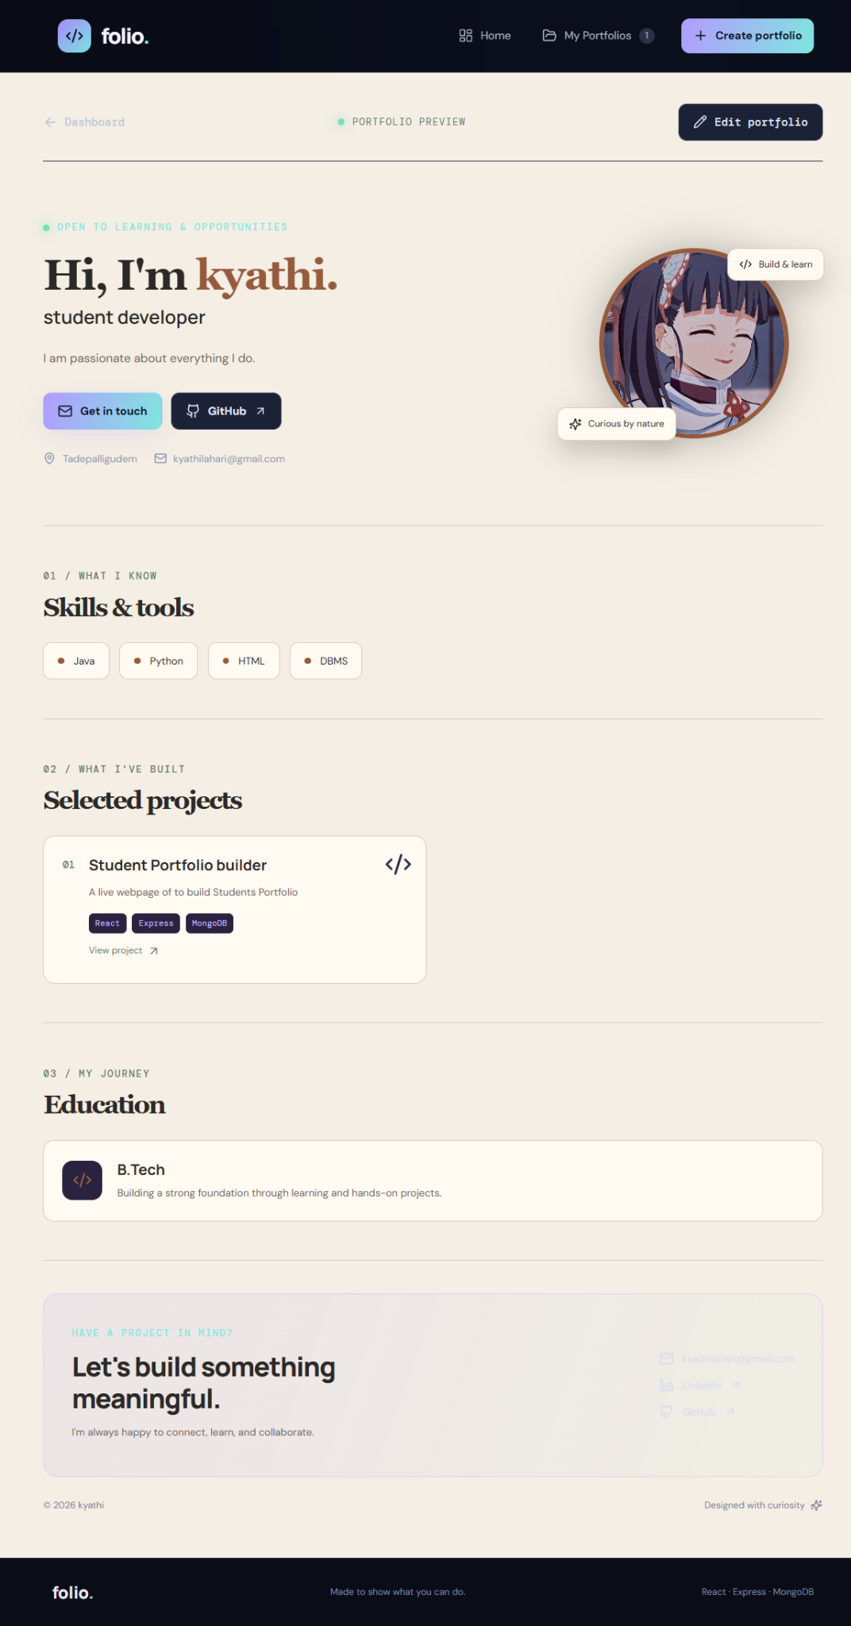
LIVE WEBSITE WALKTHROUGH
Portfolio preview
The preview turns saved information into a polished profile with skills, projects,
education and contact links.
3. Preview and present
Students can review the portfolio before sharing it with faculty, recruiters or peers.

Slide 10
07 • PROJECT VALUE
08
Key Benefits
Organized
Accessible
Maintainable
Keeps key student information together.
Can be opened in a browser through a shareable link.
Separates frontend, backend and database responsibilities.
Practical learning
Expandable
Applies frontend, API, database and deployment concepts.
Can be enhanced with more sections and design features.
One organized profile • easier sharing • room to grow

Slide 11
CONCLUSION
A simple way to present
student achievements.
Thank you!
Student Portfolio Builder brings together a browser-based interface, backend API and cloud database storage in one full-stack project.
Questions?
EXPLORE THE PROJECT
Student Portfolio Builder
↗ Live website • student-portfolio-builder-psi.vercel.app
↗ GitHub • KyathiLahari/student-portfolio-builder
09 / 09

